Slide 1
CS 540 Network Architecture
Lecture 11 : TCP for wireless networks, MANET
Prof. Younghee Lee

Slide 2
TCP for wireless Network
TCP assumes that packet loss is due to congestion.
Wireless Network:
Higher transmission error rate: error prone
Bit corruption
Frequent handoff
Burst error => time out => ss
TCP assumption in wireless network( and long fat network) is not appropriate.
Problems of TCP in wireless last-hop
Fixed + wireless link
Delays experienced at the wired and wireless links are different: flow/congestion control
Cellular/ wireless LAN => link delay varies with time
Signal jamming, etc., => packet loss => RTT => …

Slide 3
What is the problem?
Reducing cwnd make sense?
On a CDMA channel, errors occur due to interference from other user, and due to noise
Interference due to other users: an indication of congestion.
interference => transmission errors => appropriate to reduce cwnd
Noise causes errors => not appropriate to reduce cwnd.
When a channel is in a bad state for a long duration
It might be better to let TCP backoff, so that it does not unnecessarily attempt retransmissions while the channel remains in the bad state

Slide 4
Proposed Solutions
e2e protocols
Reactive: Selective ACKs (SACK), TCP-New Reno
Proactive: TCP-Vegas, TCP-Westwood..
Split connection protocols
Separate connections for wired path and wireless hop
“wireless-aware TCP” (I-TCP, ProxyTCP, Snoop-TCP, split connections...)
Reliable link layer protocols
Error correcting codes, Local retransmission

Slide 5
Various solution
IEEE database has 599 papers on Wireless TCP

Slide 6
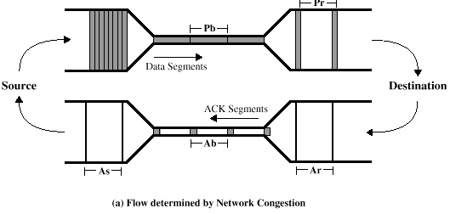
TCP Vegas
Idea: source watches for some sign that some router's queue is building up and congestion will happen soon; e.g.,
RTT is growing
sending rate flattens
TCP Vega slow start
ssthresh estimation via packet pair
Only increase every other RTT
Tests new window size before increasing
(Bottleneck Link Capacity) x Pb (or Pr or As) = (Size of a packet of packet Pair)

Slide 7
TCP Vegas Congestion Avoidance
Only reduce cwnd if packet sent after last such action
Reaction per congestion episode not per loss
Use change in observed end-to-end delay to detect onset of congestion
By comparing expected to actual throughput
Other proactive congestion detection:
(WindoeSizecurrent –WindowSizeold)x(RTTcurrent –RTTold): CARD
When network approaches congestion -> flattening of the sending rate : Tri-S

Slide 8
TCP Vegas
Algorithm
let BaseRTT be the minimum of all measured RTTs (commonly the RTT of the first packet)
if not overflowing the connection, then
ExpectedRate = CongestionWindow / BaseRTT
source calculates current sending rate (ActualRate)
Actual rate = acks / round trip time; sending rate
source compares ActualRate with ExpectedRate
Diff = ExpectedRate - ActualRate
if Diff < α
-->increase CongestionWindow linearly
else if Diff > β
-->decrease CongestionWindow linearly
else
-->leave CongestionWindow unchanged
W/RTT: number of packets per sec
cwnd is too large
increase cwnd
α
unchanged
β
decrease cwnd

Slide 9
TCP Vegas
Fine grain timers
Check RTO every time a dupack is received or for “partial ack”
If RTO expired, then re-xmit packet
Standard Reno only checks at 500ms
Allows packets to be retransmitted earlier
Not the real source of performance gain
Allows retransmission of packet that would have timed-out
Small windows/loss of most of window
Real source of performance gain
Shouldn’t comparison be against NewReno/SACK
Flaws
Sensitivity to delay variation
Poor performance evaluation

Slide 10
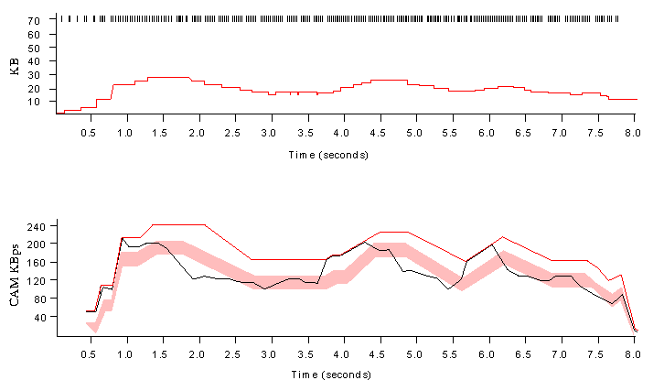
TCP Vegas
Parameters
α: 1 packet
β: 3 packets
Example trace
Even faster retransmit
keep fine-grained timestamps for each packet
check for timeout on first duplicate ACK

Slide 11
TCP Westwood (TCPW)
Sender side only modification to TCP New Reno
For better scalability and stability over high speed heterogeneous networks (including wireless)
Key idea in TCPW and ERE(Eligible Rate Estimate)
Enhance congestion control
Used to set cwnd after packet loss + to reset ssthresh to reach “cruising speed” fast from slow start ➔ good for wireless network
When three duplicate ACKs: (RE : achieved rate)
set ssthresh RE*RTT_{min} : instead of ssthresh=cwnd/2 as in Reno
If (cwnd>ssthresh) set cwnd=ssthresh
RTT_{min} is set to the smallest RTT sample observed over the duration of the connection.
When a timeout expires
set ssthresh RE*RTT_{min} : instead of ssthresh=cwnd/2 as in Reno and cwnd=1
Congestion
Window
Timeouts
may still
occur
Initial
Slowstart
Slowstart
to pace
packets
Fast
Retransmit
and Recovery
Time

Slide 12
TCP Westwood (TCPW)
ERE is estimated at the sender by sampling and exponential filtering measures from ACK stream
Samples are determined from ACK inter-arrival times and info about bytes delivered
T_{k:} interval
Packet pair: reflects link capacity
Packet train: short time throughput (aggregated data ACKed during the interval)
No congestion => small T_{k:} => close to a packet pair measurement
Congestion => larger T_{k:} => closer to a packet train measurement
Expected rate with no congestion
RE: achieved rate
Severe congestion: RE =0
t_{k} - t_{k-1}
d_{k}
(Bottleneck Link Capacity) x Pb (or Pr or As) = (Size of a packet of packet Pair)

Slide 13


TCP Westwood : BE
Bandwidth estimation
ACK reception rate
ACK conveys regarding the amount of data delivered to the destination.
Sampled bandwidth b_{k} at time t_{k} (ack reception time)
d_{k}: the amount of the data delivered,
Discrete-time filter which is obtained by discretizing a continuous low-pass filter using the Tustin approximation
1/τ is the cutoff frequency of the filter

Slide 14
TCP Westwood (TCPW)
ERE
RE: achieved rate
RE sampling
RE_{k}= α_{k}* RE_{k-1} + (1- α_{k})*((s_{k}+s_{k-1})/2):
To obtain ERE: adapt the sample interval T_{k} according to congestion level
Congestion level is similar to that in Vegas: Expected Rate - Achieved Rate
TCPW with adaptive filter (AF)
RE <= ERE <= BE
Expected rate with no congestion
RE: achieved rate

Slide 15
TCP Alternatives: TCPW-A
TCPW
after packet loss (ie, 3 DUPACKs, or Timeout), ERE is used by sender
TCPW-A: Adaptive Start
Uses ERE to adaptively and repeatedly reset ssthresh during the startup phase
Agile proving
PNCD: Persistent Noncongestion Detection => agile proving to capture more bandwidth

Slide 16
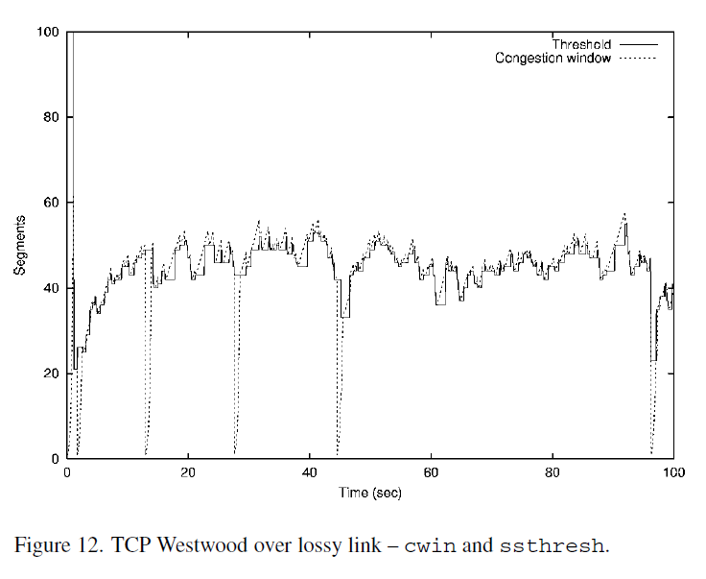
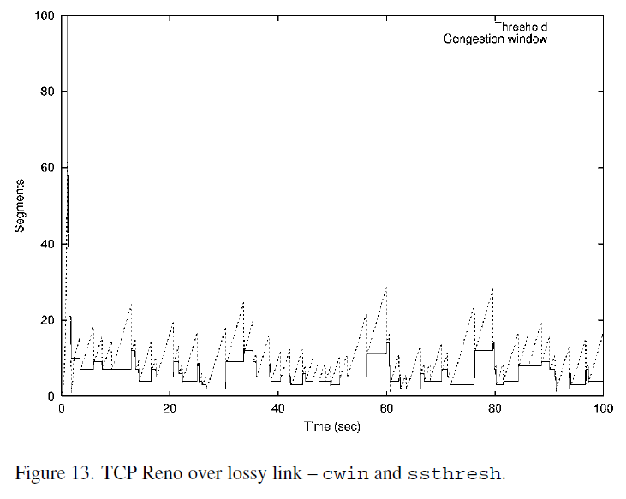
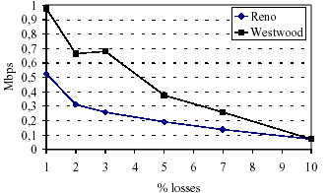
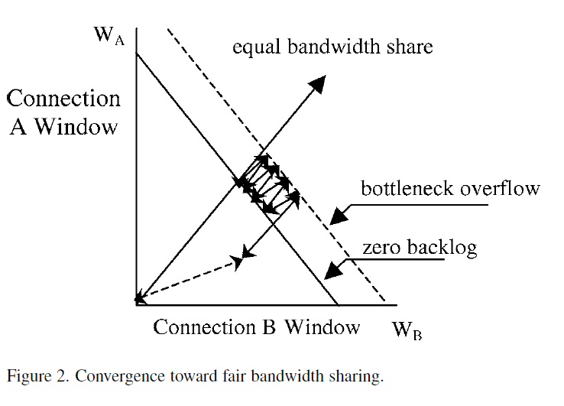
TCP Westwood (TCPW)

Slide 17
Packet Pair in Practice(FYI)
Most Internet routers are FIFO/Drop-Tail
Easy to measure link bandwidths
Bprobe, pathchar, pchar, nettimer, etc.
How can this be used?
NewReno and Vegas use it to initialize ssthresh
Prevents large overshoot of available bandwidth (by packet train)
Want a high estimate – otherwise will take a long time in linear growth to reach desired bandwidth

Slide 18
Wireless TCP
Reactive approach
TCP new Reno, TCP SACK
Proactive approach
TCP Vegas, TCP Westwood
TCP Veno
same methodology as Vegas
It further suggests a way to differentiate the cause of packet loss
If the number of backlogged packets is below a threshold
Not congested => the loss is considered to be random.
It increases the congestion window in a conservative manner
Otherwise congestive => Reno scheme

Slide 19
Wireless TCP
TCP Jersey
the available bandwidth estimation (ABE) algorithm
TCP sender side addition
continuously estimates the bandwidth available to the connection
adjust its transmission rate when the network becomes congested
the congestion warning (CW) router configuration
Routers alert end stations by marking all packets when there is a sign of incipient congestion.
sender of the TCP connection
to differentiate packet losses
calculates the optimum congestion
window size using ABE, CW
ECN at the routers to implement CW

Slide 20
Split connection approach: Indirect TCP(I-TCP)
cell2
BS
BS
cell1
FH
MH
TCP
TCP Tailored for wireless
2 TCP connections
SACK for BS <-> MH
Advantages
Optimize performance to wireless TCP
No changes to TCP for FH
Disadvantages
Violate end to end semantic: Ack..
High overhead due to dual stack at BS, high delay due to queueing delay at BS, extra copying of data at BS
Overhead is heavy when handoff is frequent
BS retains hard state: BS fails? => hand-off latency increases due to state transfer…

Slide 21
Indirect TCP(I-TCP)(2)
Implementation: proxy
MH socket
FH socket
I-TCP proxy
User space
Kernel
Socket layer
TCP layer
IP layer
To MH
To FH

Slide 22
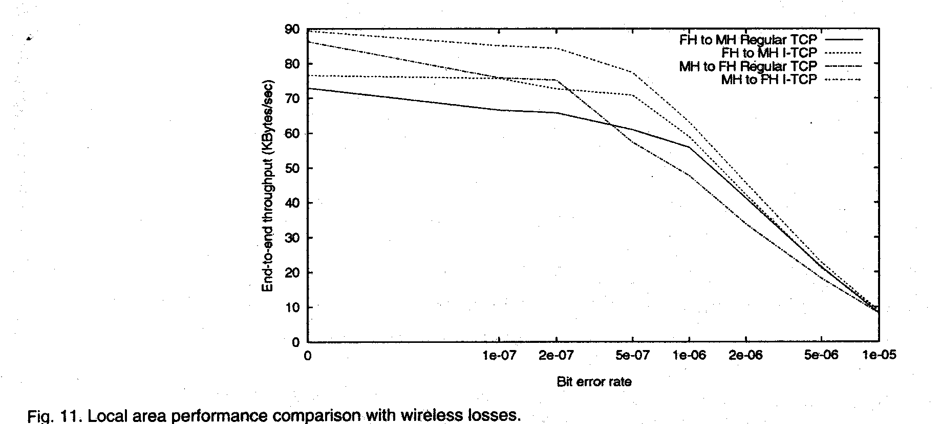
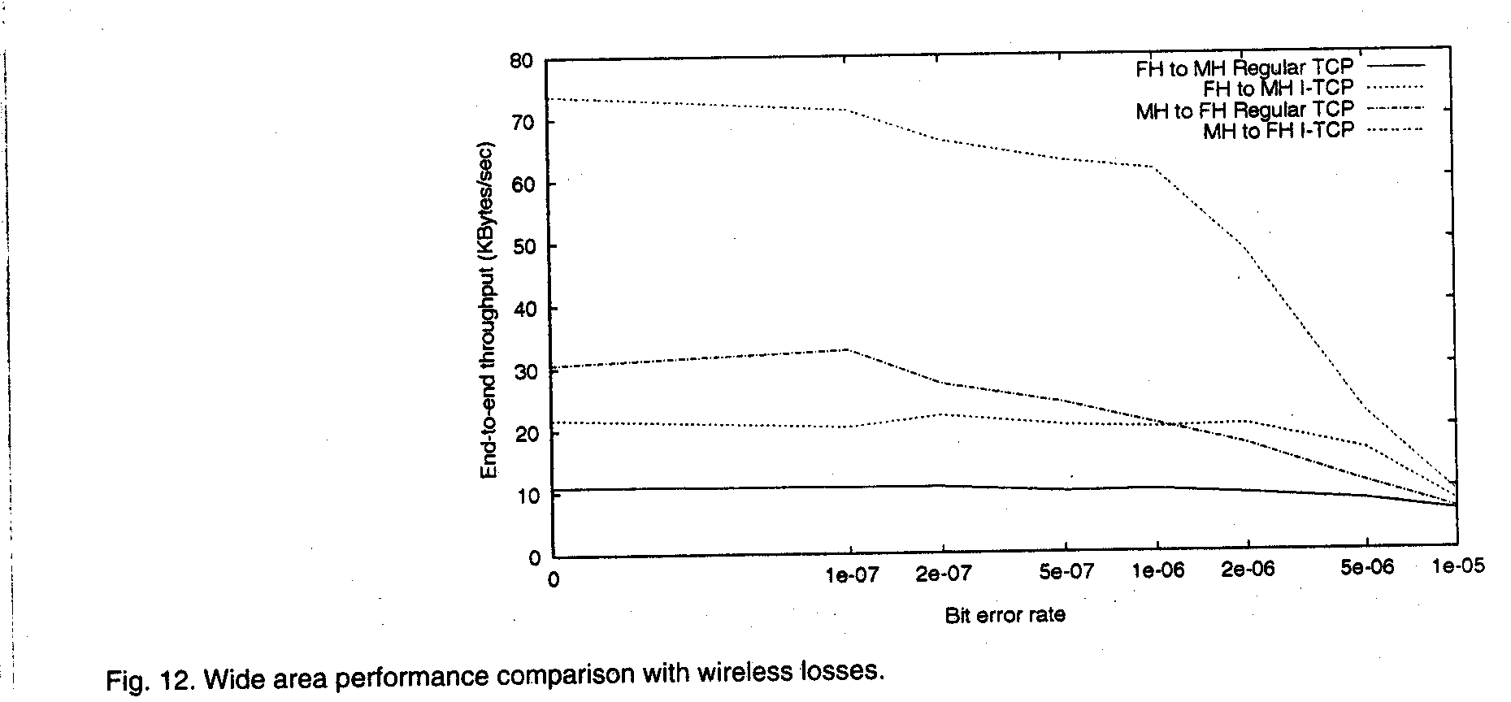
Indirect TCP(I-TCP)(3)
I-TCP
TCP
Local area throughput
Wireless link: 2Mbps
Ethernet link: 10Mbps
I-TCP(M->F)
Wide area throughput
TCP(M->F)
I-TCP(F->M)
TCP(F->M)

Slide 23
Split connection approach: Variations
cell2
BS
FH
BS
cell1
MH
TCP
SRP over UDP
Selective Repeat Protocol(SRP) over UDP for tuning to wireless behavior
Only single link: no intermediate router => reliable UDP’s are enough (?)
Mobile-End Transport Protocol
Terminate the TCP connection at BS
TCP connection runs only between BS and FH
BS pretends to be MH (MH’s IP functionality moved to BS): (metaphor: NI <-> Host)
BS guarantees reliable ordered delivery of packets to MH
BS-MH link can use any arbitrary protocol optimized for wireless link
Performance better than I-TCP
Why?
2. Asymmetric transport protocol ( Mobile-TCP)
Lower overhead protocol at MH, higher overhead protocol at BS & FH
Smaller header (header compression) , simpler on/off flow control, only error detection, no congestion control at wireless link ; BS does error correction
3. Mobile End Transport Protocol: BS pretends to be MH(MH’s IP function also)

Slide 24
TCP aware link layer : snoop
UC Berkeley for wireless last-hop network: Improves on split connection
end-to-end semantics retained
soft state at base station, instead of hard state
Snoop agent present at BS: FH to MH
Lost segments are detected and retransmitted locally
Last-hop round times are estimated
Suppression of duplicated ACKs corresponding to wireless losses avoids unnecessary invocation of fast retransmission.
retransmit on wireless link, if packet present in buffer
For MH to FH: Explicit Loss Notification(ELN): decoupling of retransmission from congestion control
NACK implementation similar to TCP SACK
Requires modification to only BS
Not useful if TCP headers are encrypted (IPsec)
BS
cell2
FH
BS
cell1
MH
Packet retransmission
TCP

Slide 25
WTCP
Motivation
Snoop hides wireless losses from the sender
But sender’s RTT estimates may be larger in presence of errors
Larger RTO results in slower response for congestion losses
WTCP protocol
WTCP performs local recovery, similar to Snoop
uses the timestamp option to estimate RTT
The base station adds base station residence time to the timestamp when processing an ack received from the wireless host
Sender’s RTT estimate: not affected by retransmissions on wireless link

Slide 26
Link level retransmission?
Advantages => No changes at TCP
Disadvantages
Possible retransmission same packet at both link layer and TCP
Reordering
Highly variable delay
Retx on ARQ
CDMA, TDMA use ARQ
AIRMAIL - ARQ and FEC
Why?
FEC?
Correctable errors hidden from the TCP sender
Incurs overhead => adaptive FEC [Eckhardt98]; choosing appropriate FEC dynamically
Possible choice
Low error rate => FEC
High / bursty error => link level retransmission

Slide 27
Link level retransmission?
Large TCP Retransmission Timeout Intervals
Good for reducing interference with link level retransmits
How many times to retransmit at the link layer before giving up?
No bound: reliable but large RTT => TCP level retransmission?
Bad for recovery from congestion losses
Need a timeout mechanism that responds appropriately for both types of losses: congestion loss? Link error?
When is that beneficial to TCP performance?
in-order delivery is beneficial to TCP: selective retransmission, Go back N
Large TCP retransmission timeout

Slide 28
TCP for multihop wireless network
Issues in multihop wireless networks
TCP for MANET
Wireless Mesh Network

Slide 29
TCP/UDP in Mobile Ad Hoc Networks
Problems of TCP in wireless ad hoc networks
Delay incurred during a route reconstruction or reconfiguration due to the mobility of nodes in the route
=> RTT => sign of congestion => SS => performance degradation
Factors that affect TCP performance
Wireless transmission errors
Multi-hop routes on shared wireless medium
For instance, adjacent hops typically cannot transmit simultaneously
Intra-flow and inter-flow contention
Route failures due to mobility
Two nearby flows
Data stream
ACKs stream

Slide 30
Mobile Ad Hoc Networks
Mobility causes route changes

Slide 31
Impact of Multi-Hop Wireless Paths [Holland99]
Connections over multiple hops are at a disadvantage compared to shorter connections, because they have to contend for wireless access at each hop
TCP Throughput using 2 Mbps 802.11 MAC

Slide 32
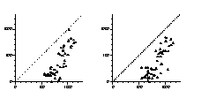
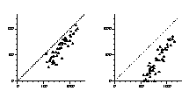
Impact of Mobility: TCP Throughput- new RENO
Ideal throughput (Kbps)
2 m/s
10 m/s
TCPW shows much better throughput than TCP new-RENO
TCP Jersey also shows better throughput than TCP new-RENO
measured throughput
20 m/s
30 m/s

Slide 33
Why Does Throughput Degrade?
Why TCP fail in MANET?
TCP misinterprets route failure or wireless error as congestion
mobility causes
link breakage,
resulting in route
failure
Route is
repaired
TCP sender times out.
Starts sending packets again
No throughput
No throughput
despite route repair
How to Improve Throughput (Bring Closer to Ideal)?
Network feedback: OK? X?
Inform TCP of route failure by explicit message
Let TCP know when route is repaired
Probing
Explicit notification
Reduces repeated TCP timeouts and backoff
TCP data and acks
en route discarded

Slide 34
Explicit Notification: Network Feedback
Need cross layer information exchange
Feedback (when routes break and repair)
Need modification of layer 3&4
Or provide failure notification
ICMP “host unreachable” ➔ TCP: suspend retransmission timer
Performance with Explicit Notification[Holland99]

Slide 35


Performance Improvement(not enough)
Without network
feedback
With feedback
2 m/s speed

Slide 36


Performance Improvement
Without network
feedback
With feedback
Actual throughput
30 m/s speed

Slide 37
Why Performance Degrades With Caching
When a route is broken, route discovery returns a cached route from local cache or from a nearby node
After a time-out, TCP sender transmits a packet on the new route.
However, the cached route has also broken after it was cached
Another route discovery, and TCP time-out interval
Process repeats until a good route is found
Need mechanisms for determining when cached routes are stale
timeout due
to route failure
timeout, cached
route is broken
timeout, second cached
route also broken

Slide 38
Approaches to TCP over Ad Hoc: TCP-F
TCP Feedback (TCP-F)
Allows the source to be informed of a route disconnection as a result of node mobility.
Link broken => upstream node detects => send Route Failure Notification(RFN) to the source
The source enters SNOOZ state
The source stops transmitting all data packets
It freeze all timers, the current cwnd size, and value of other state variables, such as RTT estimate, RTO..
It then initiates route failure timer: depend on the worst-case route repair time
When route repair complete message is received
Data transmission will be resumes and all timers and variables will be restored

Slide 39
Approaches to TCP over Ad Hoc: TCP-BuS
Enhancement introduced
Explicit notification
Explicit Route Disconnection Notification(ERDN)
Explicit Route Successful Notification(ERSN)
Extension of timeout values:
depend on a variety of factors : for further research
each node can buffer ongoing packets during a route disconnection and re-establishment
Selective retransmission
Avoidance of unnecessary requests for fast retransmission
Packets in transit before route disconnection ; Destination node continue to send ACK
Reliable transmission of control message
The source periodically sends PROBE messages to check if pivoting node receive .. or
Each intermediate node is responsible for sending an ERSN message reliably to its upstream node until it receives data packets

Slide 40
Approaches to TCP over Ad Hoc: ATCP
ATCP: TCP for Mobile Ad Hoc Networks [Liu 2001]
a thin layer inserted between the standard TCP and IP layers
explicit congestion notification (ECN) to detect congestion and distinguish congestion loss from error loss
ICMP Destination Unreachable message to detect a change of route or temporary partition
According to these feedbacks, the ATCP layer puts the TCP sender into either the persist, congestion control, or retransmit state accordingly
The scheme does not modify the TCP code
TCP semantic is maintained.

Slide 41
ATP: A Rate-based Transport Layer Protocol
Ad-hoc Transport Protocol (ATP) [Sundaresan et. al.]
Feedback from intermediate nodes
path failure, queueing delay, periodic feedback on rate
Rate based transmission
Entirely rate-controlled. (no window concept)
Evenly distribute transmissions over time. (reduce burstiness)
Decoupling of congestion control and reliability
Does not employ cumulative ACKs but solely relies on periodic SACK (with 20 SACK blocks) to identify losses.

Slide 42
TCPs over Satellite(FYR)
Long latency, Larger congestion window or larger initial window
SACK: allow multiple packet recovery per RTT
Space Communication Protocol Standard Transport Protocol (SCPS-TP)
Satellite Transport Protocol (STP): split connection approach
Early Acks:
Spoofing: Early acks from ground station result in faster congestion window growth
TCP-Peach [1]
Applications such as HTTP are based on the transfer of small files
the entire transfer occurs within the slow start phase and the connection is not able to fully utilize the available network bandwidth.
sudden start and rapid recovery with the traditional TCP’s congestion avoidance and fast retransmit algorithms
Sudden start introduces the use of dummy packets that are copies of the last data packet the sender has sent.
The sender sends multiple dummy packets between two consecutive data packets
the reception of ACKs for the dummy packets indicates the availability of the unused network resource, and the sender is triggered to increase its sending window quickly
TCP Hybla: European Satellite Network of Excellence (SatNEx) project
[1] I. F. Akyildiz, G. Morabito, and S. Palazzo, “TCP-Peach: A New Congestion Control Scheme for Satellite IP Networks,” IEEE/ACM Trans. Net., vol. 9, no. 3, June 2001, pp. 307–21.

Slide 43
Yet another TCP variants(FYI)
Impact of mobility on TCP Performance
Hand-off, Mobile IP
Rendezvous Delay ; 1 sec after cell boundary crossed
M-TCP,
Freeze TCP
During mobile handoff or temporary blockage of radio signals by obstacles.
The mobile unit predicts the impending disconnections ; signal strength
It imposes no restrictions on routers and only requires code modifications at the mobile unit or receiver side.
The freeze-TCP receiver on the mobile unit proactively sets the advertised window size to zero in the ACK packets in the presence of impending disconnection.
force the sender into persist mode, where it ceases sending more packets while keeping its sending window unchanged.
To implement, cross-layer information must be exchanged,
TCP exposed to handoff algorithms implemented by network interface card(NIC) vendors on the interface devices

Slide 44
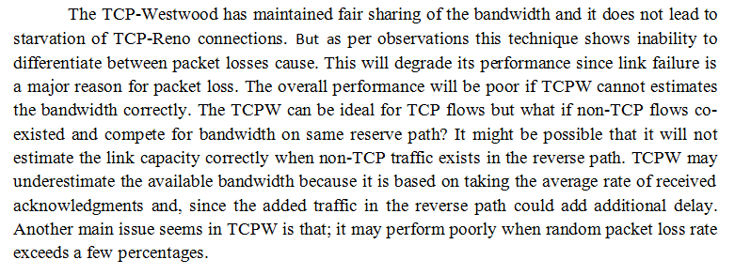
Discussion: picked up randomly

Slide 45
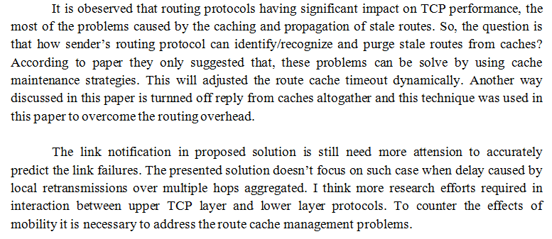
Discussion: picked up randomly

Slide 46
Discussion: picked up randomly
TCPW is a critical protocol in this era as wired networks are falling out of favour and wireless infrastructure have emerged which support mobility. In addition to that, it solves performance issues that have been haunting the networks due to mobility. Users no longer want to be confined to one place, they desire to be connected wherever and whenever. As future work, the benefits of link layer congestion control especially Snoop can be combined with TCPW to come up with a robust congestion detection and control mechanism.
The main issue in several papers has been that TCP assumes all packet loss is due to congestion, is there a mechanism that can help TCP learn that packet loss is not only an indicator of congestion in the network? The indicators chosen such as expected throughput are questionable, more work should be done to determine the appropriate metrics for TCP performance. Only TCP traffic was used in the simulation, it would be informative to see to TCP performance fares with other types of traffic in mobile ad hoc networks and if ELFN techniques would still be applicable. Lastly, more research should be conducted focusing on cache management improvement that would ultimately help improve TCP performance.

Slide 47
Discussion: picked up randomly
In this paper, the main goal is regarded to prevent the false positive on the network congestion due to wireless link failure. However, isn't the further conditional check on the congestion window size drag the fast reaction on the true positive, which is the actual congestion? In the circumstance of heavy congestion, any of the status message that will be the standard of the bandwidth estimation can be indefinitely delayed. The paper criticize itself as the TCPW performs poorly when the loss rate exceeds a few percent. Hence, the further conditional check is suspected to be the reason of it, and it is wondered that this suspicion is true.
Moreover, the paper suggests the proper update of the router caches to prevent the responding with stale routers. However, it is reminded that this kind of state keeping can't be regarded as best way. If we intentionally update or reorder the cache, it is not much different with the explicit storage of the end user profiles and intermediate router profiles. If we will allow it, it is wondered why not just keep the history of the link failures in the two profiles so that we can keep track of the link failure probability.

Slide 48
Discussion: picked up randomly
While simulation results show that TCPW flows could achieve fair shares among them, TCPW flows are not "friendly" to TCP Reno flows. However, the aggressiveness is showed1to be contained and never severe enough to lead to starvation. Future works for TCPW include comparison between TCPW and link level technique such as Snoop, further improvement of bandwidth estimation and filtering method to make TCPW more friendly, and development of control theoretical models to study about stability of TCPW.
From simulation results, we could see that TCP throughput drops greatly when node movement causes link failures, due to TCP’s inability to recognize between link failure and congestion. There are several areas for future works such as: investigation of explicit link failure notification protocol in more detail, effects of other mobile ad-hoc routing protocols have on TCP performance, and interactions between TCP and lower layer protocols when used over mobile ad-hoc networks.
Last question: Do we really need TCP over MANET? If yes, when? If no, why?

